Slide 1

Section 3 Project
Analysis for Northwind

Slide 2
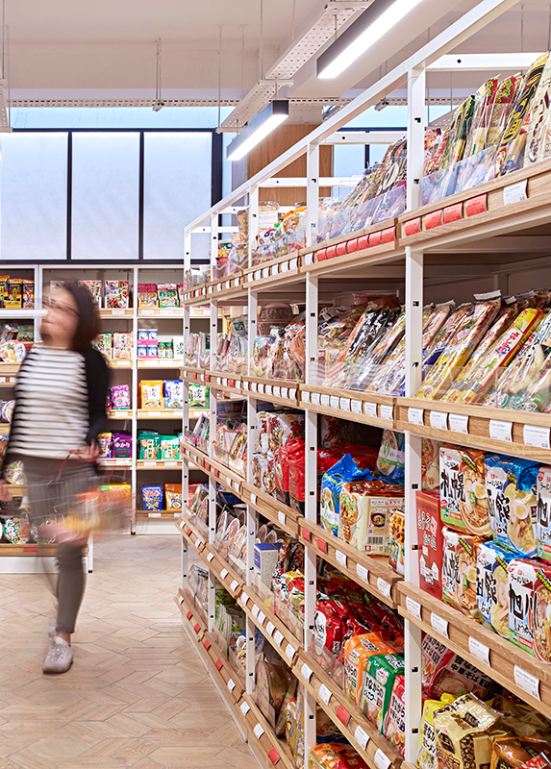
Executive summary
The business case
Effects of discounting
Hypothesis 2
Hypothesis 3
Cost of shipping firms
Possible next steps
Appendix contains additional analysis

Slide 3
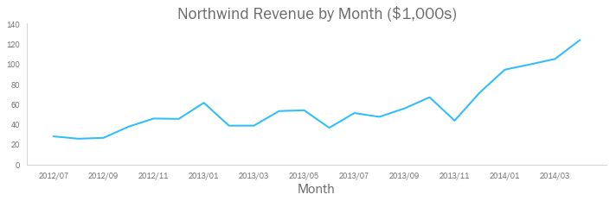
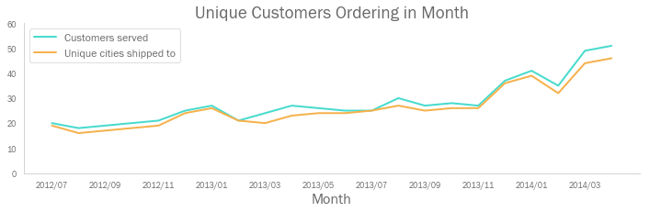
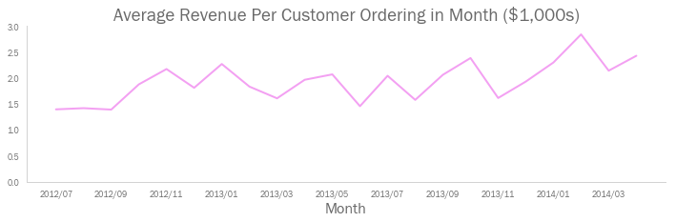
The business case
Northwind’s monthly revenues have grown quickly in the last 6 months
This is due to an increase in the number of customers, and geographic expansion
However, average revenue per customer is variable, and flat on average
Northwind should explore all potential opportunities to improve profitability

Slide 4
Are some regions more profitable than others?
Does discount amount have an effect on the quantity of a product in an order?
Do customers that order less frequently make bigger orders?
Are any of the shipping firms notably cheaper than the others?
1
Customer base
Revenue
2
Revenue per order
Revenue per customer
3
Orders per customer
Business Profit
Product costs
Unit cost of goods
Cost
Staff costs
4
Shipping costs

Slide 5
Hypothesis 1

Slide 6
The effect of discounting
Discount rate | Times offered
0% | 1317
1-5% | 192
6-10% | 174
15% | 157
20% | 161
25% | 154

Slide 7
Hypothesis 3

Slide 8
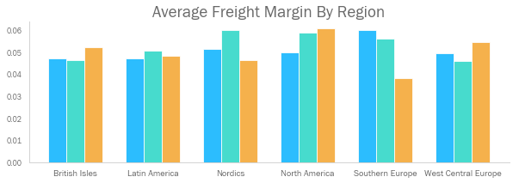
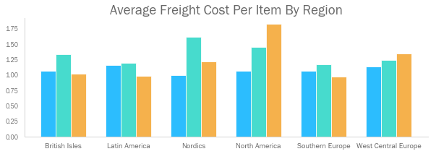
The cost of shipping firms
Three shipping companies are used across regions. CB91 ran tests across two cost KPIs to determine if any one company is significantly cheaper in a given region.
Region | Company to Use
British Isles | Any
Latin America | Any
Nordics | Speedy Express
North America | Speedy Express
Southern Europe | Federal Shipping
West / Central Europe | United Package
Speedy Express
United Package
Federal Shipping

Slide 9

Possible next steps
There are further hypotheses we could test to drive revenue and reduce cost:
TBC

Slide 10
Thank you for your time
Further detail on the model, and additional analysis of the dataset is included in further pages

Slide 11
A note on hypothesis testing

Slide 12
A note on Monte Carlo simulations

Slide 16
The cost of shipping firms – in more detail
Company | Region | KPI | Comparison to Others | P-Value | Reject
Speedy Express | West Central Europe | Freight Margin | Less | 0.49296 | Do not reject Null Hypothesis
Speedy Express | West Central Europe | Freight Cost Per Item | Less | 0.17020 | Do not reject Null Hypothesis
Speedy Express | Latin America | Freight Margin | Less | 0.31006 | Do not reject Null Hypothesis
Speedy Express | Latin America | Freight Cost Per Item | Greater | 0.40138 | Do not reject Null Hypothesis
Speedy Express | North America | Freight Margin | Less | 0.30510 | Do not reject Null Hypothesis
Speedy Express | North America | Freight Cost Per Item | Less | 0.04936 | Reject Null Hypothesis
Speedy Express | Nordics | Freight Margin | Less | 0.37700 | Do not reject Null Hypothesis
Speedy Express | Nordics | Freight Cost Per Item | Less | 0.04330 | Reject Null Hypothesis
Speedy Express | Southern Europe | Freight Margin | Greater | 0.04454 | Reject Null Hypothesis
Speedy Express | Southern Europe | Freight Cost Per Item | Less | 0.49180 | Do not reject Null Hypothesis
Speedy Express | British Isles | Freight Margin | Less | 0.40284 | Do not reject Null Hypothesis
Speedy Express | British Isles | Freight Cost Per Item | Less | 0.37556 | Do not reject Null Hypothesis
United Package | West Central Europe | Freight Margin | Less | 0.04186 | Reject Null Hypothesis
United Package | West Central Europe | Freight Cost Per Item | Less | 0.49992 | Do not reject Null Hypothesis
United Package | Latin America | Freight Margin | Greater | 0.27982 | Do not reject Null Hypothesis
United Package | Latin America | Freight Cost Per Item | Greater | 0.30470 | Do not reject Null Hypothesis
United Package | North America | Freight Margin | Greater | 0.41868 | Do not reject Null Hypothesis
United Package | North America | Freight Cost Per Item | Greater | 0.59066 | Do not reject Null Hypothesis
United Package | Nordics | Freight Margin | Greater | 0.06632 | Do not reject Null Hypothesis
United Package | Nordics | Freight Cost Per Item | Greater | 0.02202 | Reject Null Hypothesis
United Package | Southern Europe | Freight Margin | Greater | 0.24076 | Do not reject Null Hypothesis
United Package | Southern Europe | Freight Cost Per Item | Greater | 0.24450 | Do not reject Null Hypothesis
United Package | British Isles | Freight Margin | Less | 0.27622 | Do not reject Null Hypothesis
United Package | British Isles | Freight Cost Per Item | Greater | 0.12556 | Do not reject Null Hypothesis
Federal Shipping | West Central Europe | Freight Margin | Greater | 0.02996 | Reject Null Hypothesis
Federal Shipping | West Central Europe | Freight Cost Per Item | Greater | 0.16532 | Do not reject Null Hypothesis
Federal Shipping | Latin America | Freight Margin | Less | 0.46678 | Do not reject Null Hypothesis
Federal Shipping | Latin America | Freight Cost Per Item | Less | 0.23416 | Do not reject Null Hypothesis
Federal Shipping | North America | Freight Margin | Greater | 0.35682 | Do not reject Null Hypothesis
Federal Shipping | North America | Freight Cost Per Item | Greater | 0.06570 | Do not reject Null Hypothesis
Federal Shipping | Nordics | Freight Margin | Less | 0.11028 | Do not reject Null Hypothesis
Federal Shipping | Nordics | Freight Cost Per Item | Less | 0.37198 | Do not reject Null Hypothesis
Federal Shipping | Southern Europe | Freight Margin | Less | 0.00364 | Reject Null Hypothesis
Federal Shipping | Southern Europe | Freight Cost Per Item | Less | 0.25942 | Do not reject Null Hypothesis
Federal Shipping | British Isles | Freight Margin | Greater | 0.20586 | Do not reject Null Hypothesis
Federal Shipping | British Isles | Freight Cost Per Item | Less | 0.20116 | Do not reject Null Hypothesis
CB91 ran a Monte Carlo simulation across all permutations of shipping company, region, and cost KPI
Each test used 50,000 simulations, with an alpha of 0.05
The hypotheses for each test were also automated, taking the following forms:
H₀: Company KPI in region = KPI in region of other two companies
H_{a}: Company KPI in region {<, >}* KPI in region of other two companies
* nature of inequality is automatically determined based on whether company’s average cost in that KPI was above or below the market average

Slide 17
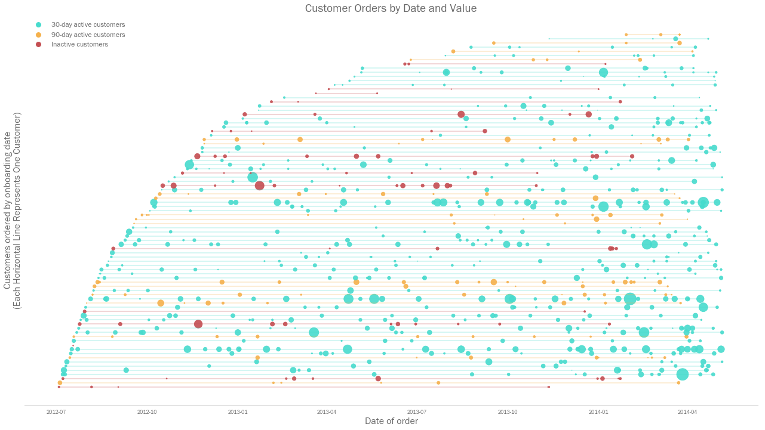
A lifetime view of Northwind’s orders
Additional Analysis
Each horizontal line represents the time line of one customer, and each circle represents an individual order that they have made. Circle size represents the value of that order.

